Slide 1




Social inequalities in musculoskeletal ageing among community dwelling older men and women in the United Kingdom
HE Syddall¹, M Evandrou², C Cooper¹, A Aihie Sayer^{1,3}
¹ MRC Lifecourse Epidemiology Unit
² Centre for Research on Ageing
³Academic Geriatric Medicine, University of Southampton of Southampton
Notes:
My name is Holly Syddall and I am an epidemiologist and medical statistician based at the MRC Lifecourse Epidemiology Unit. I am an experienced researcher having worked at the MRC since 1997 but only in the past few years did I get around to completing a PhD and it is this work on Social inequalities in musculoskeletal ageing among community dwelling older men and women in the UK which I would like to present to you today.

Slide 2
Background
Musculoskeletal disorders are a major problem in older people and place a substantial burden on UK health and social care services
The UK has an ageing population
Improved understanding of the patterns and determinants of musculoskeletal ageing is needed for planning of health and social care services, and development of interventions to promote healthy ageing at the individual level.
Notes:
Musculoskeletal disorders such as loss of muscle strength and physical function, falls, frailty, and osteoporosis, are a major problem in older people and place a substantial burden on UK health and social care services.
The UK has an ageing population. In 2010, 17% of the UK population was aged 65 years and over; this proportion is projected to increase to 23% by 2035. The already substantial burden of musculoskeletal disorders will only increase over time as the population ages.
Improved understanding of the patterns and determinants of musculoskeletal ageing is needed for both planning of health and social care services, and for development of interventions to promote health ageing at the individual level.

Slide 3
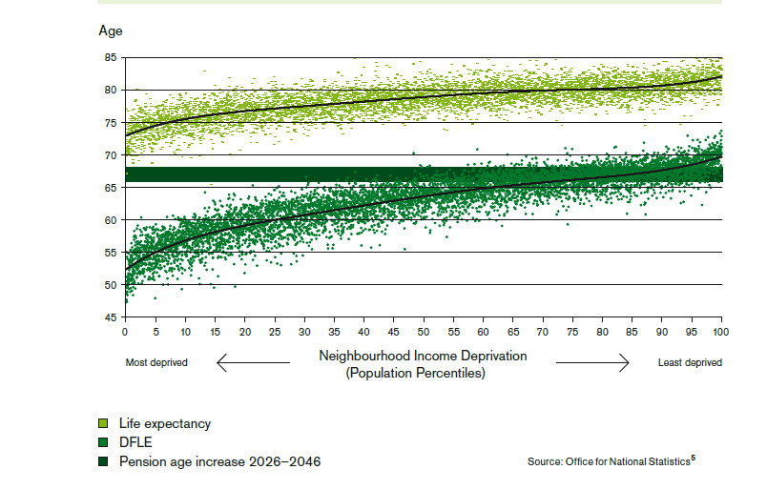
Background
Social inequalities in health have been recognised for centuries
Even in generally wealthy Western countries, health inequalities exist across relative levels of deprivation
(Reproduced from “Fair society, healthy lives”, Marmot Review final report, 2010)
Little is known about social inequalities in musculoskeletal ageing
Notes:
Social inequalities in health have been recognised for centuries.
Even in generally wealthy Western countries, health inequalities exist across relative levels of deprivation.
This figure from the 2010 Marmot review on social inequalities in health shows Life expectancy and disability free life expectancy (DFLE) at birth according to neighbourhood income level in England, 1999-2003. There is a graded association between social circumstances and health such that people living in the poorest neighbourhoods will, on average, die seven years earlier than people living in the richest neighbourhoods and the average difference in disability-free life expectancy is 17 years.
However, little is known about social inequalities in musculoskeletal ageing.

Slide 4
Objective
To explore social inequalities in musculoskeletal ageing using data from community dwelling ‘young-old’ men and women, aged 59-73 years, who participated in the Hertfordshire Cohort Study (HCS)
Notes:
I addressed this gap in knowledge by examining the evidence for social inequalities in……

Slide 5
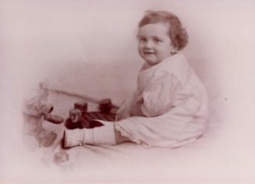
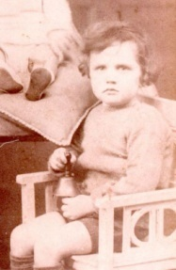

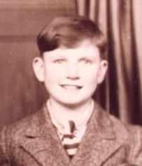

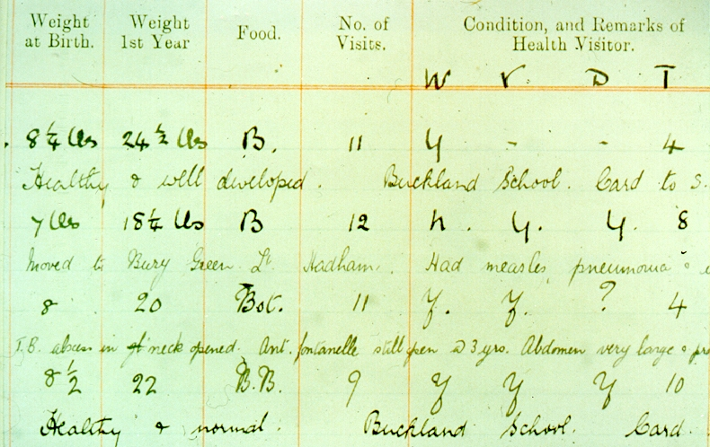
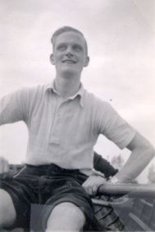
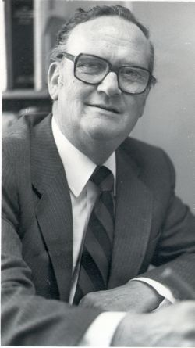
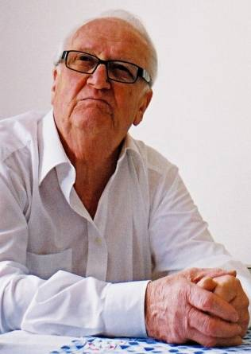
Methods: the Hertfordshire Cohort Study
A study of lifecourse influences on human health, ageing and disease
2997 men and women born 1931 – 1939
Methods paper: Syddall et al, IJE 2005
Notes:
The Hertfordshire Cohort Study is an internationally renowned study of lifecourse influences on human health, ageing and disease.
The cohort consists of 2997 men and women who were born in the country of Hertfordshire, which is just north of Greater London, between 1931 – 1939 and who still lived there in the late 1990s. The men and women completed a nurse administered home interview and attended a clinic for detailed characterisation of their health, lifestyle and socioeconomic circumstances.
A detailed description of the study has been published and showed that HCS participants are comparable with those in the nationally representative Health Survey for England (Syddall et al, IJE 2005) which limits concerns about bias and generalisability of results obtained from the HCS.

Slide 6




Methods: data availability
Socioeconomic position and material deprivation
Age left full time education
Social class in adulthood
Housing tenure
Car availability
Notes:
The specific data from HCS that were relevant to my research were as follows.
SEP and mat dep were characterised by….social class in adulthood based on most recent full time occupation or the husband’s for ever married women….

Slide 7
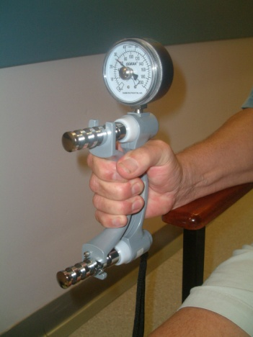
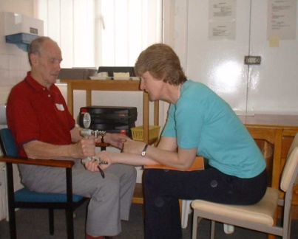
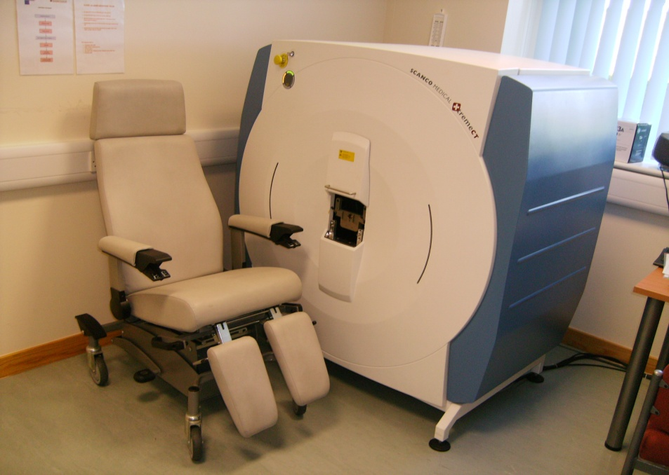
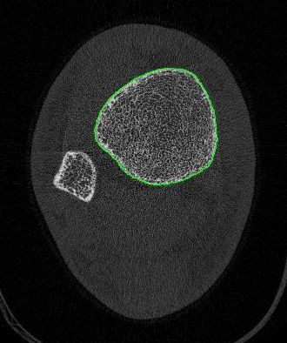
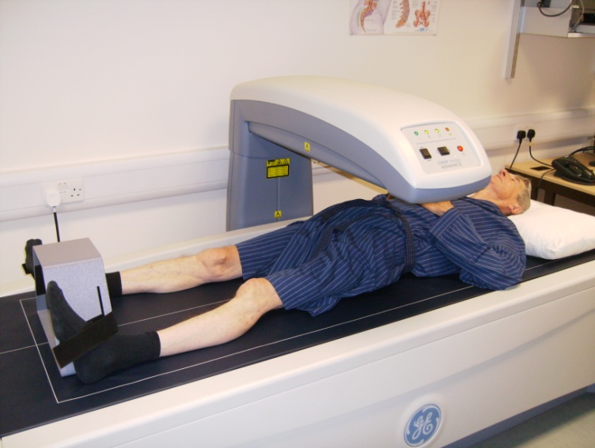
Methods: data availability
Socioeconomic position and material deprivation
Age left full time education
Social class in adulthood
Housing tenure
Car availability
Musculoskeletal ageing
Grip strength (maximum, Jamar)
Self-assessed physical function (SF-36)
History of falls in the past year
Fried frailty
Fracture history (any/minor trauma)
DXA scan (total femoral BMD and bone loss rate)
Novel pQCT scanning of radius and tibia (strength strain indices)
Notes:
The specific data from HCS that were relevant to my research were as follows.
SEP and mat dep were characterised by….
Data on musculoskeletal ageing included….define Fried frailty as presence of at least three of weight loss, weakness, exhaustion, slowness and low activity
In addition, data on Potential confounders and co-morbidities included Age, height, weight, smoking, alcohol, marital status, walking speed, comobidities and prescribed medications
(if asked: comorbs=IHD, stroke/TIA, hypertension, bronchitis, diabetes, minor trauma fracture since age 45 years, hand OA.)
(if asked: bone loss rate was annualised over median of 4 year followup)

Slide 8
Results: socioeconomic position and material deprivation
% |  | Men (N=1684) |  | Women (N=1541)
Left full time education ≤14 years of age |  | 19.4 |  | 17.9
Manual social class (IIIM,IV,V) |  | 59.3 |  | 58.4
Housing tenure | Owned/mortgaged Rented/other | 80.7 19.3 |  | 76.9 23.1
Household car availability | None 1 2 3+ | 6.4 53.5 32.9 7.3 |  | 17.1 58.0 21.4 2.9
Notes:
Insert table of summary stats by gender for key sep and musculo markers here
Shade in MRC blue bands perhaps

Slide 9
Results: musculoskeletal ageing
Mean (SD) or % |  | Men (N=1684) |  | Women (N=1541)
Grip strength (kg) |  | 44.0 (7.5) |  | 26.5 (5.8)
Fallen in the past year |  | 14.9 |  | 22.6
Fried frailty |  | 4.1 |  | 8.5
Any fracture since 45 years of age |  | 14.0 |  | 21.6
Minor trauma fracture since 45 years of age |  | 7.7 |  | 18.4
DXA total femoral BMD (g/cm²) |  | 1.04 (0.13) |  | 0.90 (0.13)
Sample sizes men/women: grip 1572/1415; falls 941/1398; frailty 320/318; DXA BMD 498/468

Slide 10
Results: social inequalities in grip strength
P<0.001
P<0.001
P<0.0001
P<0.0001
Notes:
Overall, I identified clear evidence for social inequalities in muscle based aspects of musculoskeletal ageing but no convincing evidence for a social gradient in bone health. I will show you some examples of my results.
This slide shows average grip strength by car availability in the top half, and by home ownership in the bottom half, with figures for men in blue and women in pink. We see that having fewer cars available to the household, and not owning one’s home, was associated with lower grip strength in both men and women.

Slide 11
Results: social inequalities in grip strength
46kg
27kg
40kg
24kg
Fully adjusted p-values: p=0.02 for housing tenure and p=0.03 for car availability in men; p=0.004 for housing tenure and p=0.002 for cars in women
Notes:
This figure shows average grip strength according to car availability dovetailed with housing tenure.
We see that these markers of material deprivation combined together such that average grip strength decreased from 46kg among men who had more than 3 cars available and who owner occupied their home, to only 40kg among men who had no cars available and who rented their home. Patterns were similar in women.
These differences in average grip strengths are sizeable and clinically meaningful. For example, a 5kg decrease in grip strength has previously been shown to be associated with a 1.5 fold increase in the odds of having difficulty in performing 3 or more ADLs. (Ensrud 1994)

Slide 12
Results: social inequalities in physical functioning
52%
42%
14%
15%
Poor PF defined as a score in the lowest fifth of the sex-specific distribution (<=75 for men; <=60 for women). Fully adjusted p-values: p=0.003 for housing tenure and p<0.001 for car availability in men; p=0.12 for housing tenure and p=0.05 for cars in women
Notes:
Results were similar for physical functioning. This figure shows the prevalence of poor self-reported physical functioning according to car availability and housing tenure. We see that in men, and in women, having fewer cars available, and not owner occupying one’s home, was associated with greater likelihood of having poor physical function.

Slide 13
Results: social inequalities in Fried frailty
p=0.01 men
p=0.16 women
p=0.05 men
p=0.02 women
% Frail
Number of cars available
for household use
Home
ownership
Men Women
Notes:
This final results slide shows the prevalence of Fried frailty by car availability and home ownership. We see that having fewer cars available for household use was associated with an increased prevalence of frailty among men, and that not owner occupying one’s home was associated with an increased prevalence of frailty among men and women.
In contrast to all this clear evidence for a social gradient in muscle based aspects of musculoskeletal ageing, there was no convincing evidence, in men or women, for any social gradient in fracture history, DXA total femoral bone mineral density (BMD) and bone loss rate, or pQCT strength strain indices for the radius or tibia.

Slide 14
Discussion
Recap: we have identified a specific pattern of evidence for social inequalities in muscle, but not bone, based aspects of musculoskeletal ageing
Notes:
So, we have identified a specific pattern of evidence for social inequalities in muscle, but not bone, based aspects of musculoskeletal ageing

Slide 15
Discussion
Recap: we have identified a specific pattern of evidence for social inequalities in muscle, but not bone, based aspects of musculoskeletal ageing
Why?
Notes:
Why?
I focused on grip strength and total femoral BMD as objectively measured phenotypes of muscle and bone and by further data analysis and literature searching I considered the role that anthropometry, physical activity, diet, and smoking and alcohol may have played in my results.

Slide 16
Discussion
Recap: we have identified a specific pattern of evidence for social inequalities in muscle, but not bone, based aspects of musculoskeletal ageing
Why?
different social patterning
and
different associations of muscle and bone with
height and fat mass
diet
physical activity
Notes:
I concluded that evidence for a social gradient in muscle but not bone is plausible and very likely arises due to differences in the social patterning of height, fat mass, diet and physical activity, and the varying influence of these factors on ageing muscle and bone.

Slide 17
Discussion
Recap: we have identified a specific pattern of evidence for social inequalities in muscle, but not bone, based aspects of musculoskeletal ageing
Why?
different social patterning
and
different associations of muscle and bone with
height and fat mass
diet
physical activity
Responsiveness of ageing muscle and bone to physical activity
Further research is needed to identify the impact of different types of physical activity (resistance/aerobic; customary/occupational) on social inequalities in musculoskeletal ageing
Notes:
In addition, the literature suggests that ageing skeletal muscle remains highly responsive to physical activity in later life in a way that ageing bone does not and this could have contributed to my results; I suggest that further research is needed to identify the impact of different types of physical activity across the lifecourse (resistance/aerobic; customary/occupational) on social inequalities in musculoskeletal ageing

Slide 18
Conclusions
Any clinical interventions designed to reduce the loss of muscle mass and function with age should be targeted proportionately across the social gradient; strategies to reduce fracture and osteoporosis should continue with a universal population focus
There exists a subgroup of older men and women in the UK who face increased levels of material deprivation in combination with greater loss of muscle strength and physical function
It is these men and women who urgently need the government to commit to reform of the funding system for adult care and support
Notes:
So, in conclusion…..this research suggests that any clinical interventions …..
In addition, this research has identified a subgroup of older men and women in the UK who face increased levels of material deprivation in combination with greater loss of muscle strength and physical function….this not only informs planning and provision of health and social care services….but also identies a subgroup of older men and women who urgently….
Thank you for the opportunity to speak to you today, I’m very happy to now take any questions. (Move on to leave Acknowledgements slide up)

Slide 19
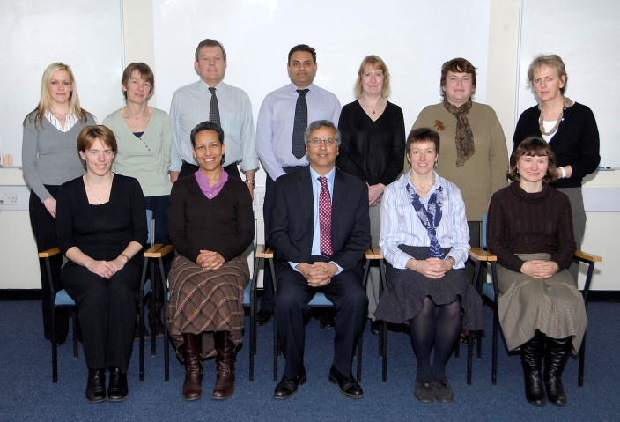
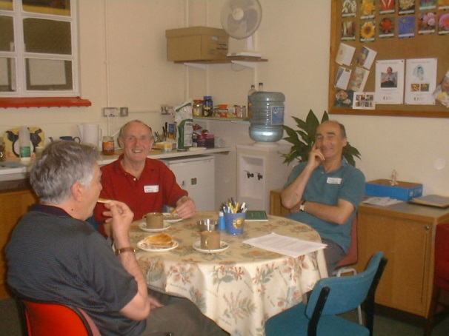
Acknowledgements
Study participants
Hertfordshire GPs
Hertfordshire Cohort Study Team
Professors Avan Aihie Sayer, Maria Evandrou and Cyrus Cooper
Funding:
  MRC
  University of Southampton
  BHF, ARC, NOS, Wellcome Trust

